Slide 1
2018 report figures/stats

Slide 2
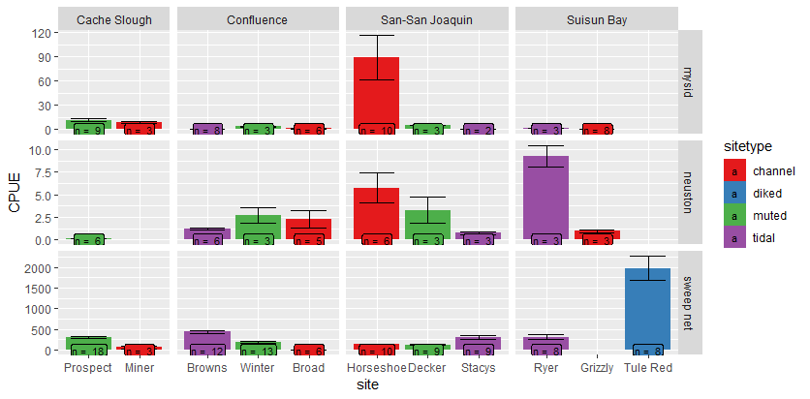
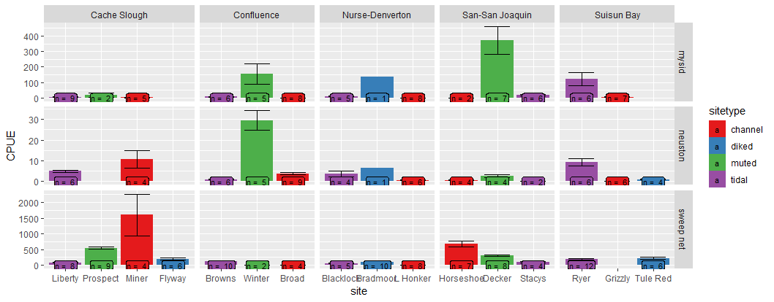
CPUE
2017
2018

Slide 3
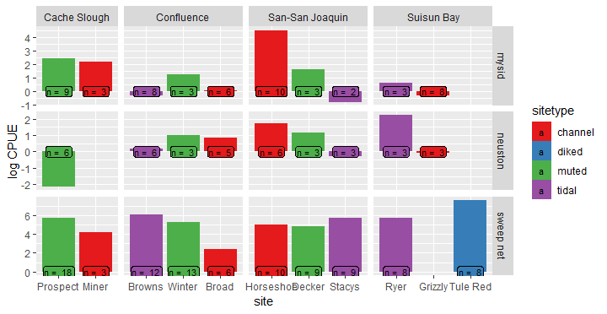
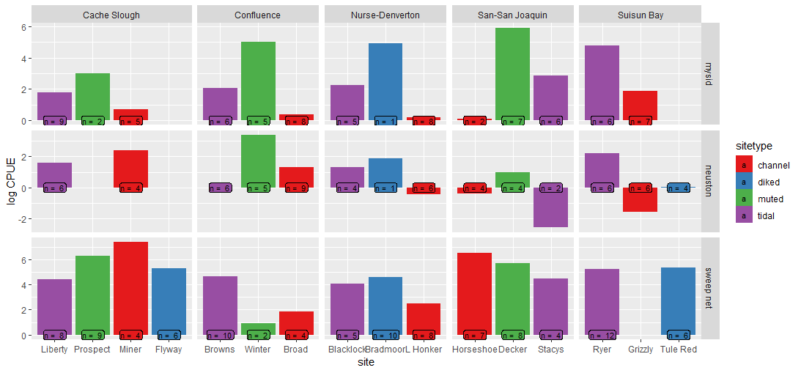
CPUE –log transformed
2017
2018

Slide 4
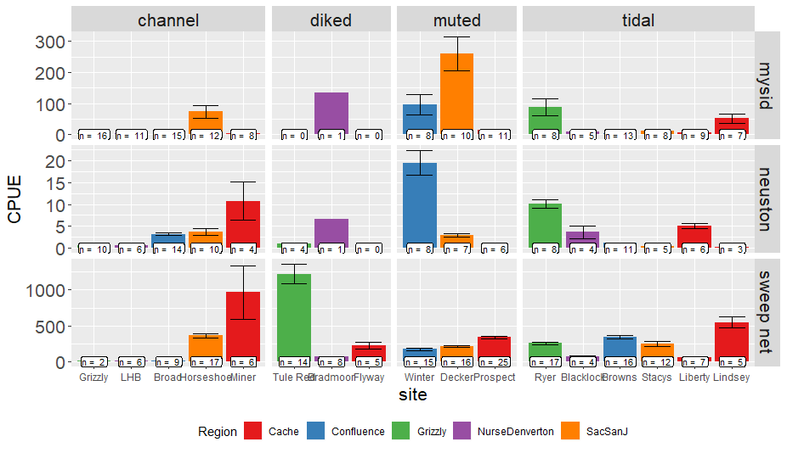
CPUE – both years together

Slide 5
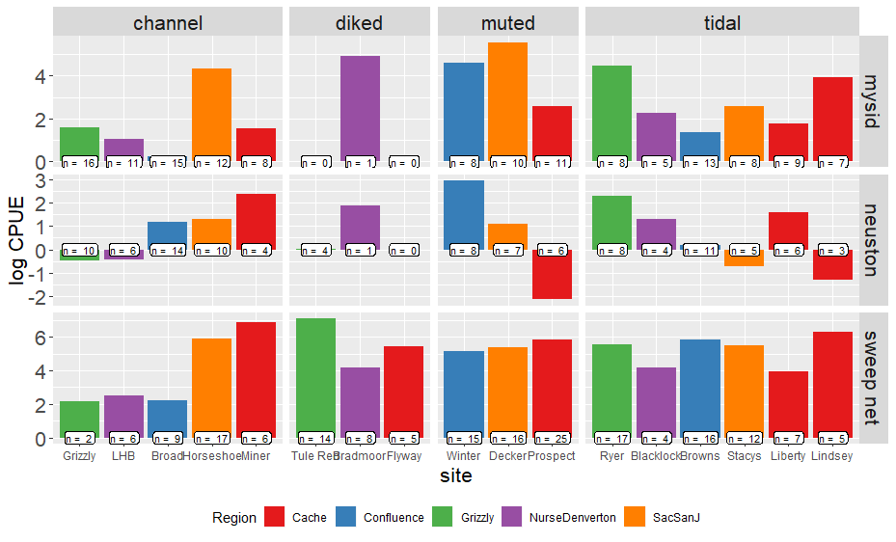
CPUE – log-transformed

Slide 6
GLMM
Log(CPUE+1) ~ Gear + sitetype + Error(Site)
 | Estimate | Std. Error | df | t value | Pr(>|t|)
(Intercept: Channel, mysids) | 1.1574 | 0.223 | 15.7878 | 5.19 | <0.0001 | ***
Sitetype: diked | 1.0441 | 0.3741 | 21.252 | 2.791 | 0.01087 | *
Sitetype: muted | 1.0029 | 0.3307 | 10.8019 | 3.032 | 0.01162 | *
Sitetype: tidal | 0.4462 | 0.2935 | 11.6847 | 1.52 | 0.15498
Gear: neuston | -0.5131 | 0.1804 | 429.1981 | -2.844 | 0.00467 | **
Gear: sweep net | 2.7004 | 0.1613 | 435.1671 | 16.741 | < 0.0001 | ***
Post-hoc shows wetland sites have higher catch overall from channel sites, but wetlands are not different from each other.
Earlier analyses with AIC did not support use of Year or Region as predictor variables

Slide 7
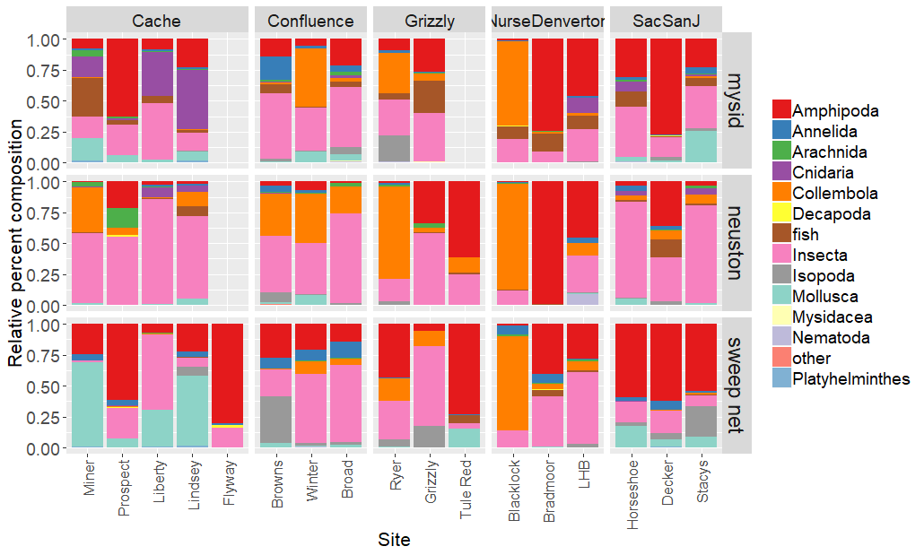
Notes:
Separate by year?

Slide 8
Multivariates
Permanova
 | Df | SumsOfSqs | MeanSqs | F.Model | R2 | Pr(>F)
Region | 4 | 6. 861 | 1.715 | 11.305 | 0.073 | 0.001 | ***
SiteType | 3 | 8.527 | 2.841 | 18.733 | 0.091 | 0.001 | ***
Habitat | 2 | 7.960 | 3.979 | 26.232 | 0.0849 | 0.001 | ***
site | 9 | 7.629 | 0.848 | 5.587 | 0.081 | 0.001 | ***
Residuals | 414 | 62.811 | 0.152 |  | 0.669
Total | 432 | 93.79 |  |  | 1

Slide 9
NMDS issues
I can’t get it to converge with two years of data at all the sites
One year at a time?
Average by site?
Just show NMDSs for the pairwise comparisons?
Show non-convergent solution?

Slide 10
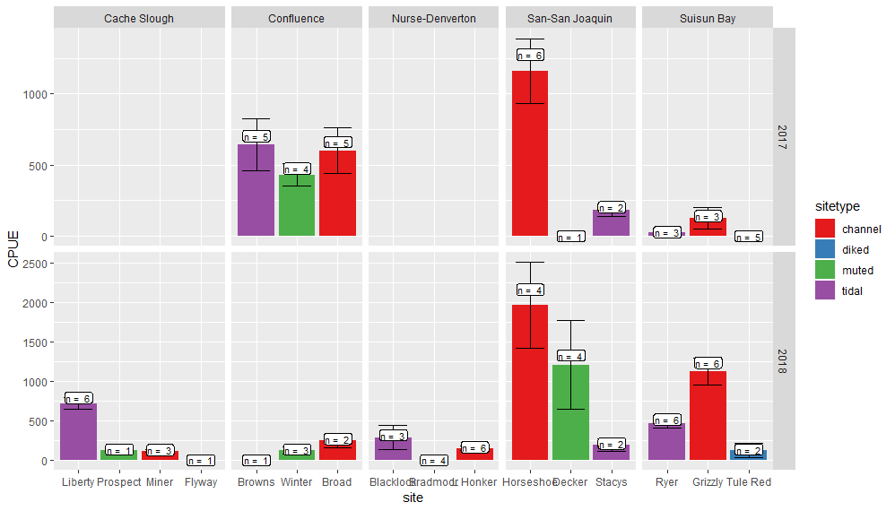
Clams
Since we changed the way we processed benthic samples this year, I’m planning on a separate analysis just of invasive clams

Slide 11
Clam logCPUE
LogCPUE ~ sitetype + Region + Year + error(site)
Best model via AICc
 | Estimate | Std. Error | df | t value | Pr(>|t|)
(Intercept) | 4.791 | 1.028 | 23.387 | 4.662 | 0.000 | ***
sitetypediked | -4.609 | 0.925 | 7.982 | -4.980 | 0.001 | **
sitetypemuted | -1.642 | 0.905 | 7.409 | -1.815 | 0.110
sitetypetidal | -0.891 | 0.673 | 6.502 | -1.323 | 0.230
Region2Confluence | -0.225 | 1.071 | 14.446 | -0.210 | 0.837
Region2Nurse-Denverton | -1.499 | 1.039 | 12.275 | -1.444 | 0.174
Region2San-San Joaquin | 0.464 | 1.028 | 11.876 | 0.451 | 0.660
Region2Suisun Bay | -0.018 | 0.963 | 9.218 | -0.019 | 0.985
Year22018 | 1.276 | 0.582 | 75.740 | 2.193 | 0.031 | *

Slide 12
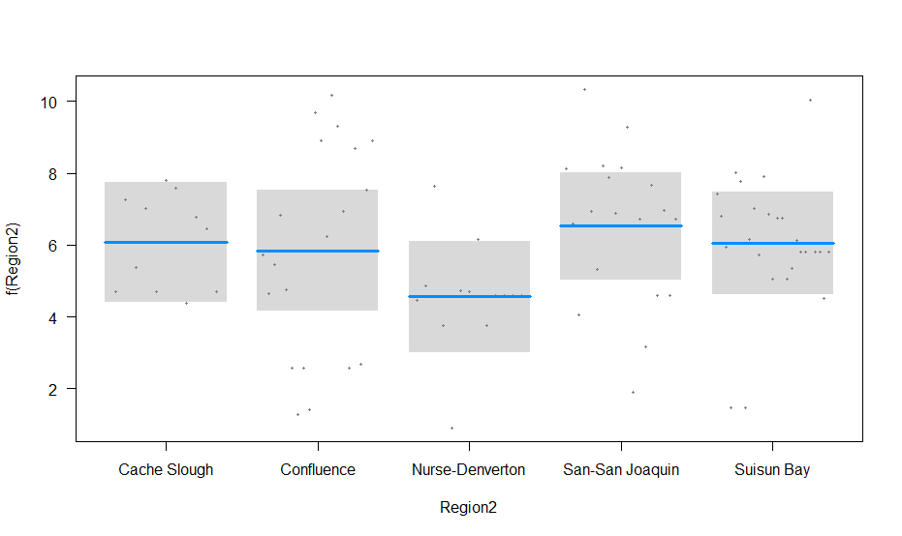
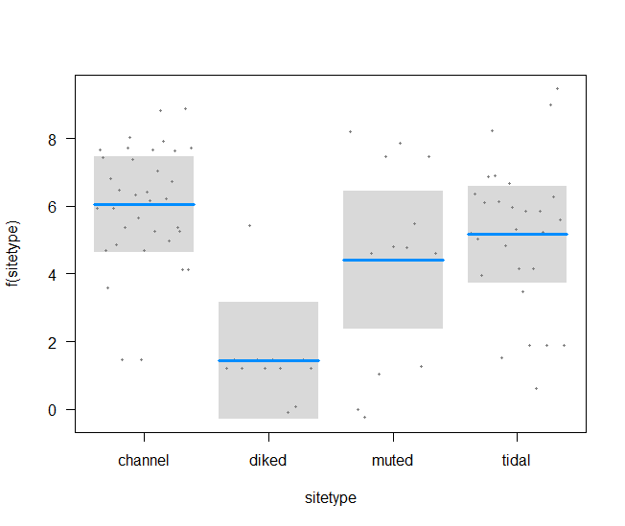
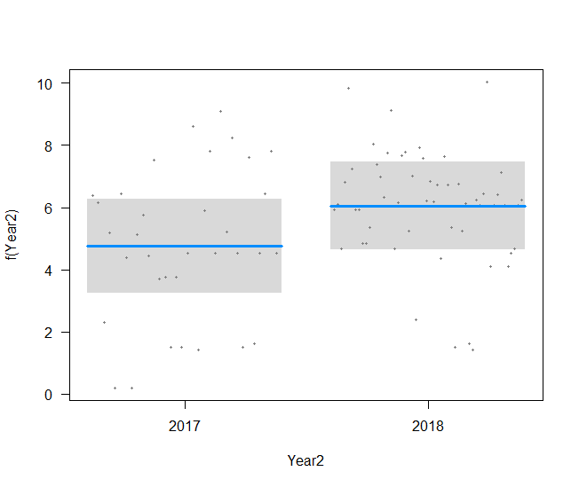
Clams
NS
A
A
A
B
B
A

Slide 13
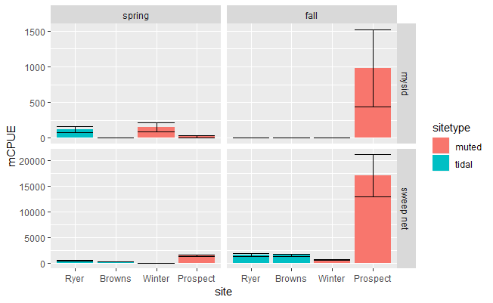
Spring versus Fall – macroinverts CPUE

Slide 14
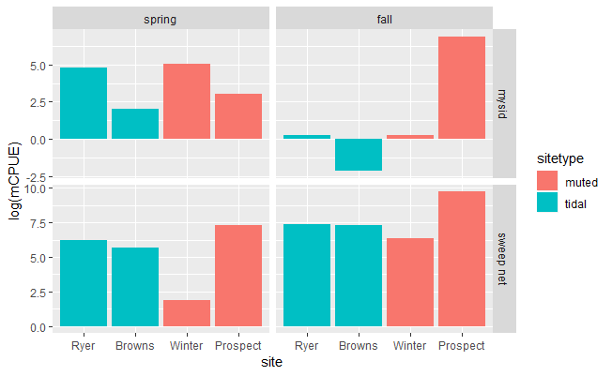
Log-transformed CPUE

Slide 15
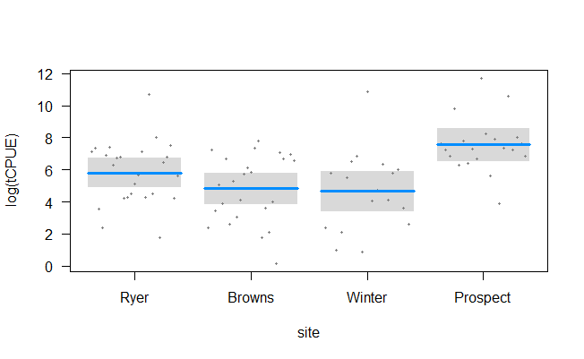
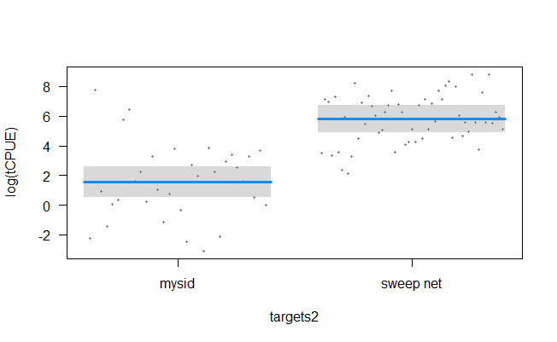
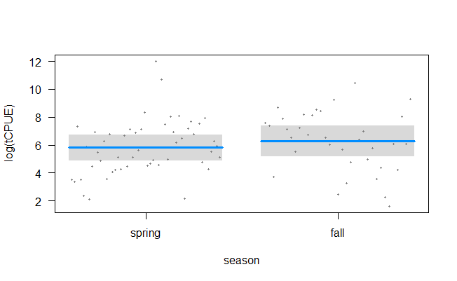
Spring versus Fall - macroinverts
 | Estimate | Std. Error | t value | Pr(>|t|)
(Intercept – mysid, ryer, spring) | 1.563 | 0.528 | 2.959 | 0.004 | **
Site: Browns | -0.999 | 0.589 | -1.698 | 0.093 | .
Site: Winter | -1.157 | 0.674 | -1.718 | 0.090 | .
Site: Prospect | 1.748 | 0.630 | 2.775 | 0.007 | **
Gear: sweep | 4.250 | 0.470 | 9.037 | 0.000 | ***
Season: fall | 0.471 | 0.466 | 1.011 | 0.315
C
B
A
AB
NS
B
A

Slide 16
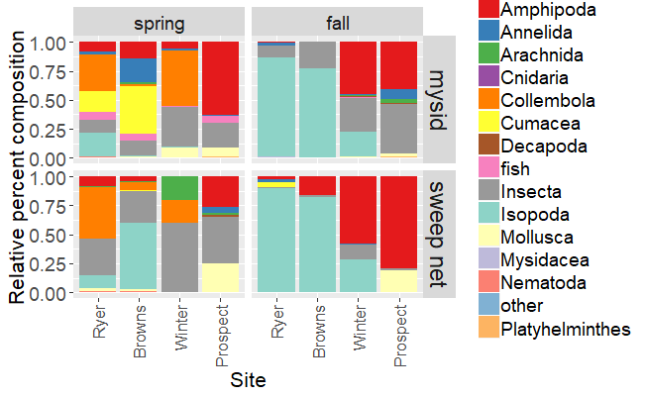
Spring v Fall multivariates

Slide 17
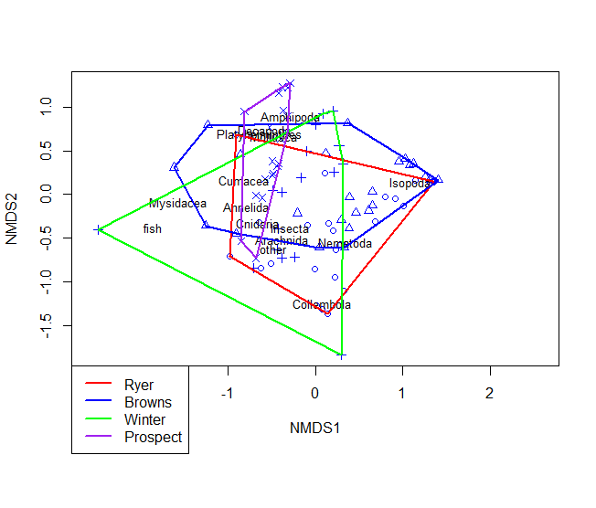
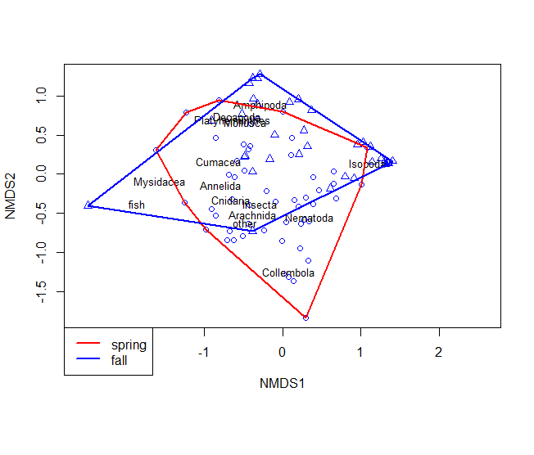
Spring v Fall PErmanova
 | Df | SumsOfSqs | MeanSqs | F.Model | R2 | Pr(>F)
Site | 3 | 5.6911 | 1.897 | 11.1194 | 0.24275 | 0.001 | ***
Gear | 1 | 0.7332 | 0.7332 | 4.2978 | 0.03128 | 0.002 | **
season | 1 | 3.2007 | 3.2007 | 18.7607 | 0.13652 | 0.001 | ***
Residuals | 81 | 13.8191 | 0.1706 |  | 0.58945
Total | 86 | 23.4442 |  |  | 1

Slide 18
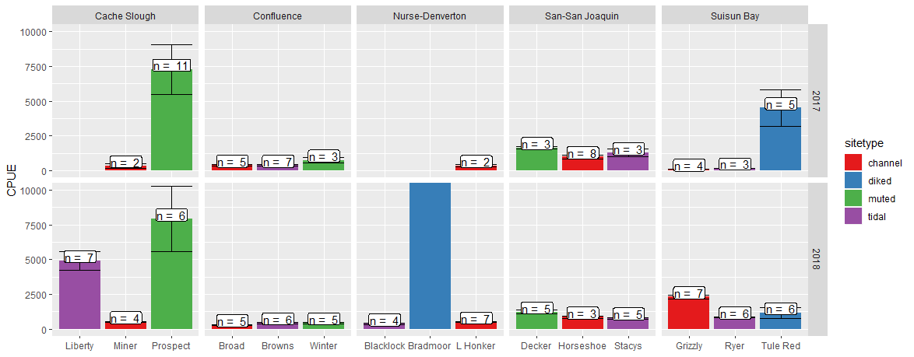
Zooplankton CPUE – spring blitz
CPUE = 135,198
N = 6

Slide 19
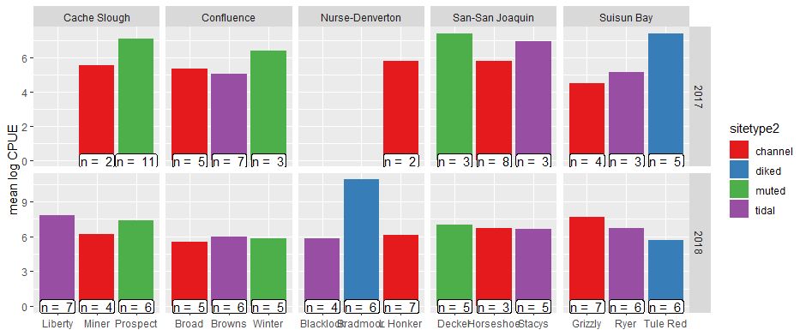
Zooplankton log cpue

Slide 20
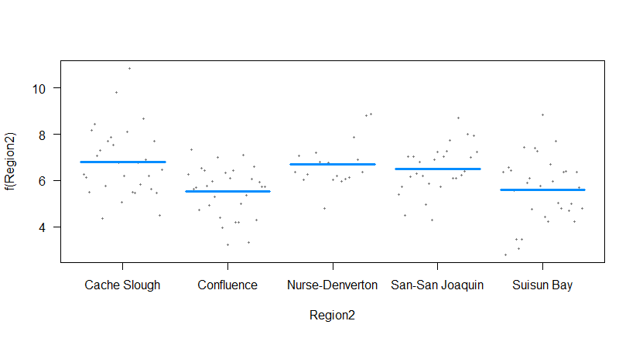
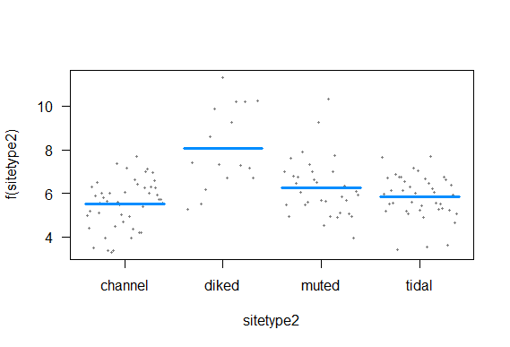
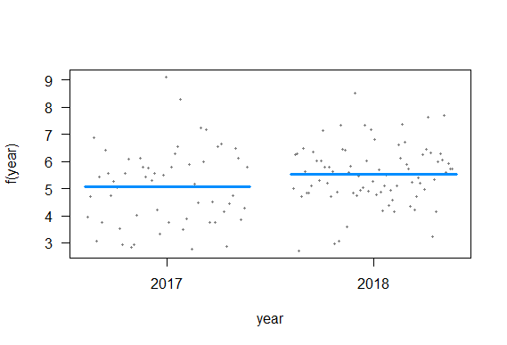
Log(CPUE)~ Region + sitetype + year + Error(site)
 | Estimate | Std. Error | df | t value | Pr(>|t|)
(Intercept – Cache, channel, 2017) | 6.345 | 0.788 | 7.414 | 8.057 | 0.000 | ***
Region - Confluence | -1.281 | 0.888 | 6.462 | -1.444 | 0.196
Region - Nurse-Denverton | -0.102 | 1.005 | 7.256 | -0.101 | 0.922
Region - San-San Joaquin | -0.283 | 0.892 | 6.584 | -0.317 | 0.761
Region - Suisun Bay | -1.200 | 0.983 | 6.651 | -1.221 | 0.264
Sitetype - diked | 2.560 | 1.009 | 6.623 | 2.537 | 0.041 | *
Sitetype - muted | 0.737 | 0.841 | 6.456 | 0.876 | 0.412
Sitetype - tidal | 0.330 | 0.695 | 6.739 | 0.475 | 0.650
year2018 | 0.451 | 0.245 | 124.870 | 1.839 | 0.068 | .
NS
B
NS
A
A
A
Notes:
I tried just looking at the 2018 data, and removing Bradmoor, but none of that helped.
Should I try just calanoid copepods?

Slide 21
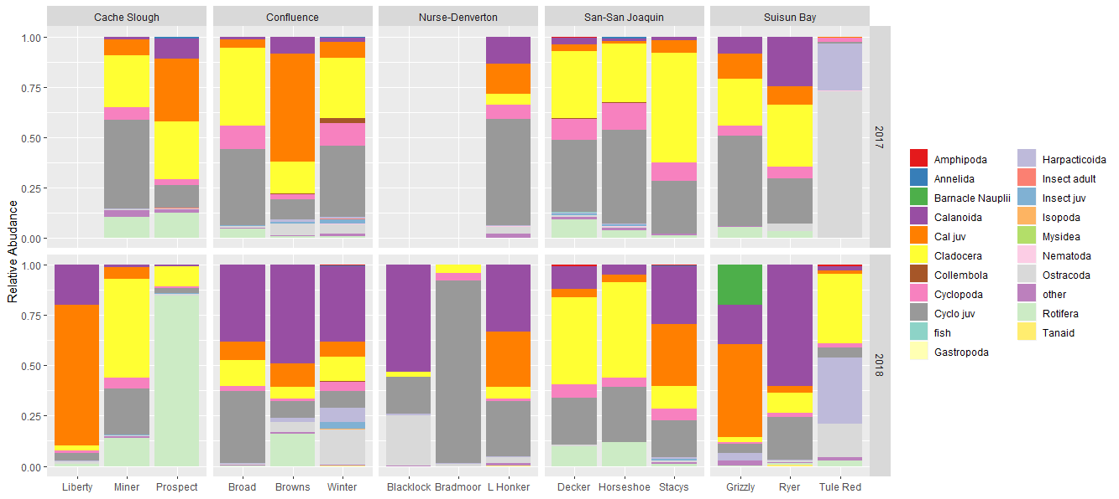
Zooplankton

Slide 22
Zooplankton Permanova
 | Df | SumsOfSqs | MeanSqs | F.Model | R2 | Pr(>F)
Region2 | 4 | 4.687 | 1.17174 | 7.8249 | 0.1566 | 0.001 | ***
sitetype2 | 3 | 4.3552 | 1.45173 | 9.6946 | 0.14551 | 0.001 | ***
year | 1 | 1.5705 | 1.57051 | 10.4878 | 0.05247 | 0.001 | ***
Residuals | 129 | 19.3172 | 0.14975 |  | 0.64542
Total | 137 | 29.9299 |  |  | 1
Notes:
No convergent solutions on NMDS

Slide 23
Pairwise comparisons
I need to add zooplankton and clam graphs to some of the comparisons
Should I subset just “fish food” critters? It seems as though the more we learn the more we find all fish eat whatever is there.

Slide 24
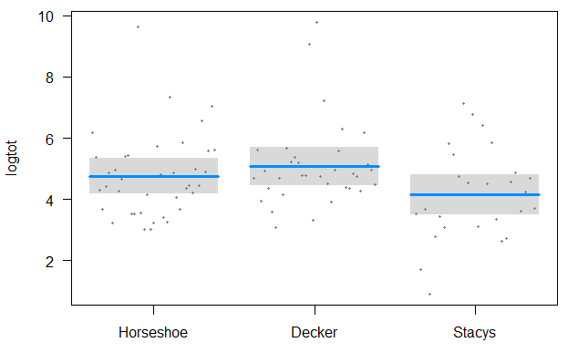
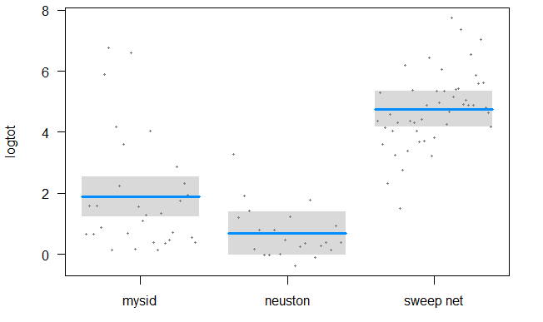
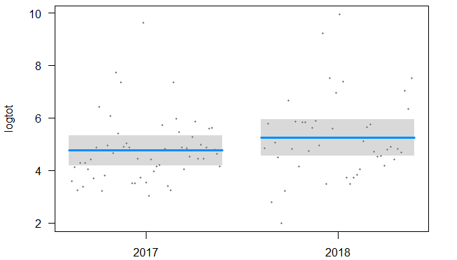
Stacy’s v Decker v Horseshoe bend
Macroinvert blitz
A
C
AB
B
A
B
ANOVA of log total CPUE
NS
 | Df | Sum Sq | Mean Sq | F value | Pr(>F)
site | 2 | 15.26 | 7.63 | 3.74 | 0.0274 | *
targets2 | 2 | 291.85 | 145.92 | 71.54 | <2e-16 | ***
Year2 | 1 | 5.46 | 5.46 | 2.675 | 0.1053
Residuals | 93 | 189.7 | 2.04

Slide 25
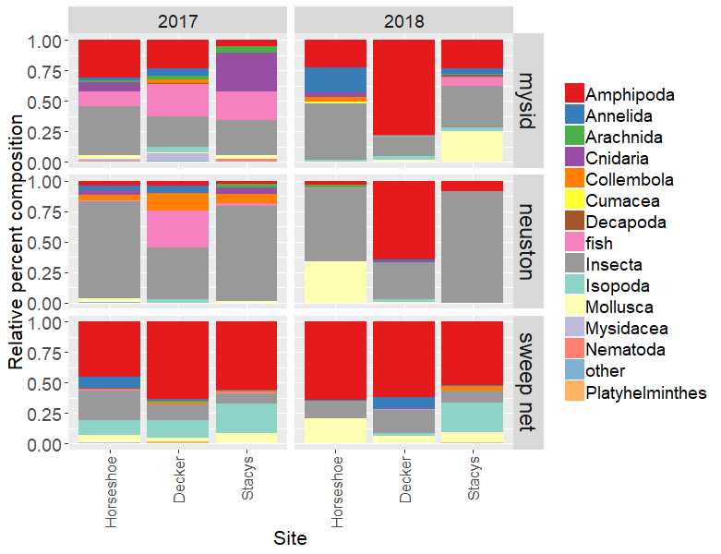
PERMANOVA
Stacy’s v Decker v Horseshoe bend
Macroinvert blitz
 | Df | SumsOfSqs | MeanSqs | F.Model | R2 | Pr(>F)
site | 2 | 1.46 | 0.73417 | 5.7648 | 0.081 | 0.001 | ***
Year | 1 | 0.70 | 0.70782 | 5.5579 | 0.039 | 0.004 | **
targets2 | 2 | 4.04 | 2.02407 | 15.8933 | 0.224 | 0.001 | ***
Residuals | 93 | 11.84 | 0.12735 |  | 0.655
Total | 98 | 18.06 |  |  | 1

Slide 26
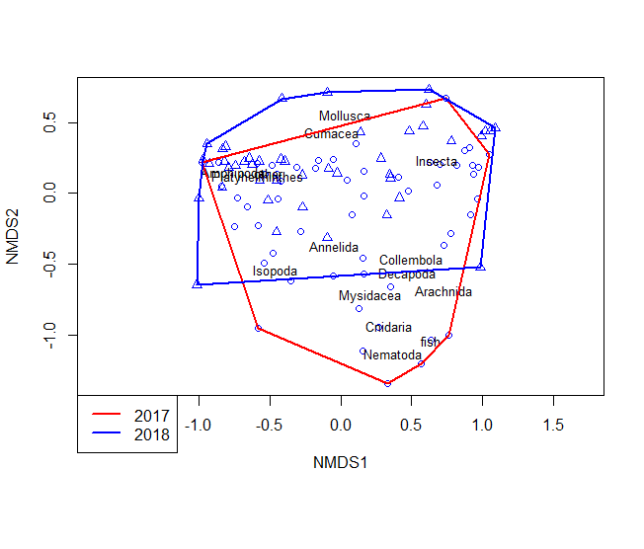
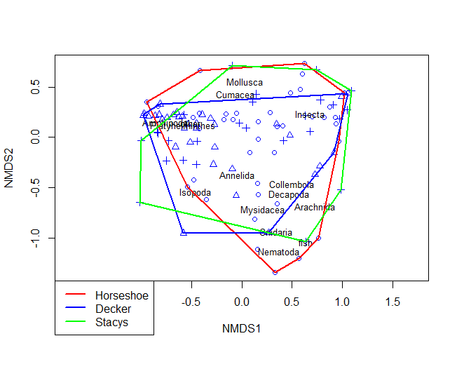
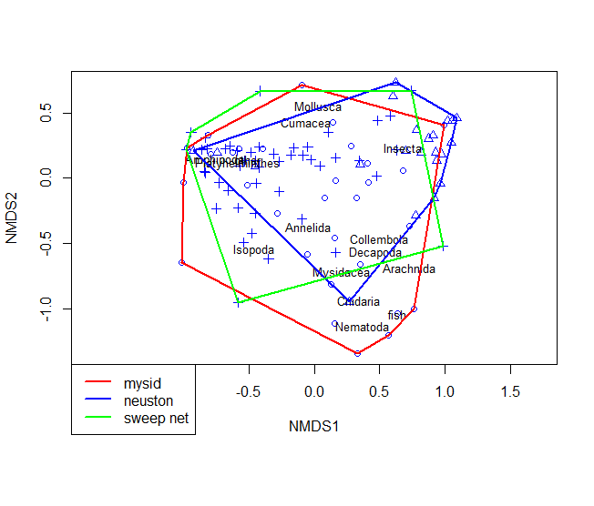
NMDS
Stacy’s v Decker v Horseshoe bend
Macroinvert blitz

Slide 27
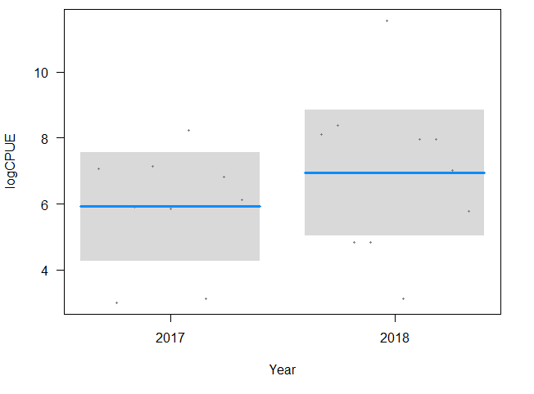
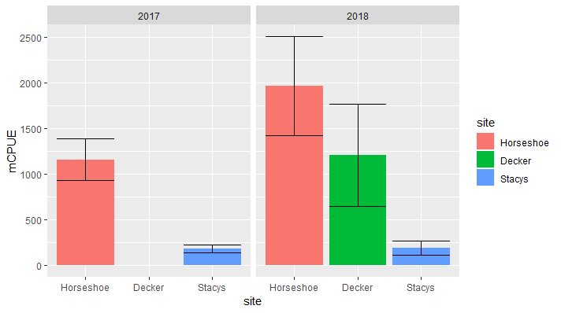
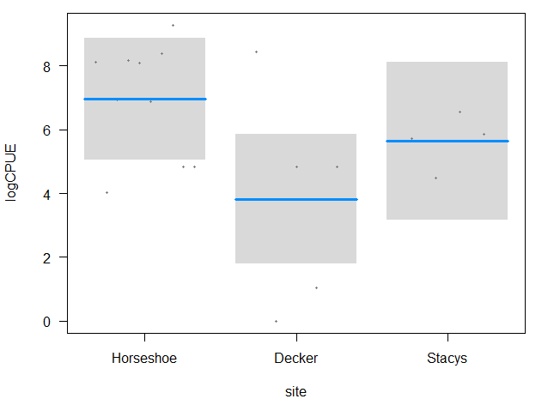
Clams
Stacy’s v Decker v Horseshoe bend
CLAMS anova
 | Df | Sum Sq | Mean Sq | F value | Pr(>F)
site | 2 | 24.89 | 12.443 | 2.423 | 0.122
Year | 1 | 4.47 | 4.465 | 0.87 | 0.366
Residuals | 15 | 77.02 | 5.134

Slide 28
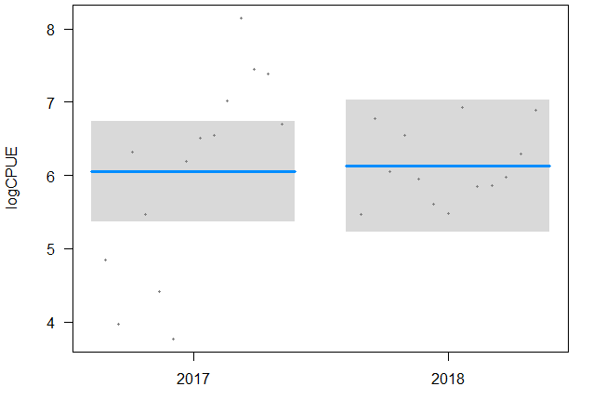
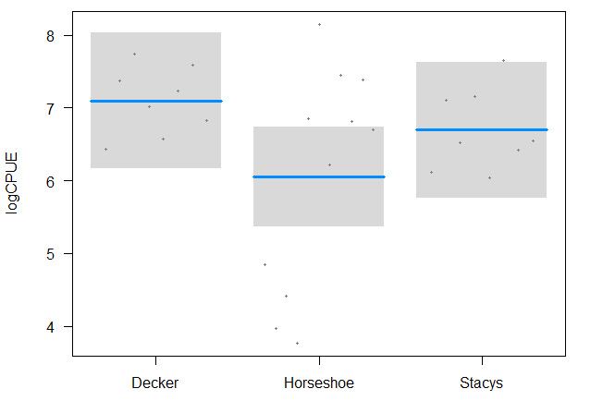
Zooplankton log(CPUE)~ site + year
Stacy’s v Decker v Horseshoe bend
Zooplankton Anova
 | Df | Sum Sq | Mean Sq | f value | Pr(>F)
site | 2 | 5.583 | 2.7915 | 2.356 | 0.117
year | 1 | 0.035 | 0.0355 | 0.03 | 0.864
Residuals | 23 | 27.252 | 1.1849

Slide 29
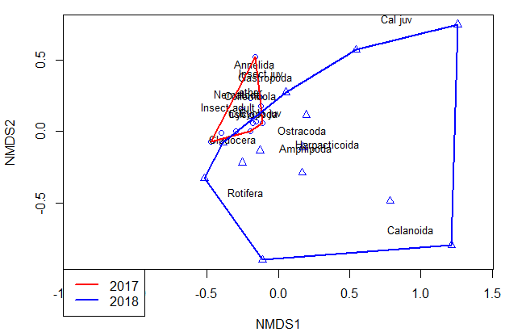
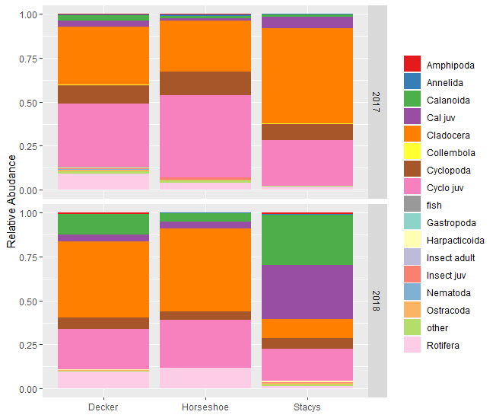
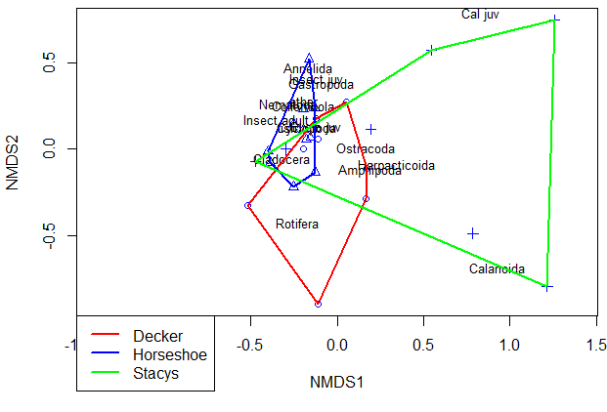
Zooplankton blitz Permanova and NMDS
Stacy’s v Decker v Horseshoe bend
NMDS stress = 0.1198
Zooplankton PERMANOVA
 | Df | SumsOfSqs | MeanSqs | F.Model | R2 | Pr(>F)
site | 2 | 0.563 | 0.281 | 3.464 | 0.204 | 0.001 | ***
year | 1 | 0.333 | 0.333 | 4.095 | 0.120 | 0.002 | **
Residuals | 23 | 1.868 | 0.081 |  | 0.676
Total | 26 | 2.764 |  |  | 1.000

Slide 30
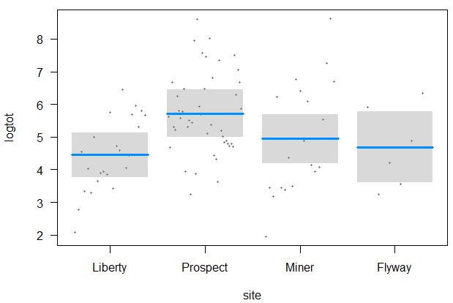
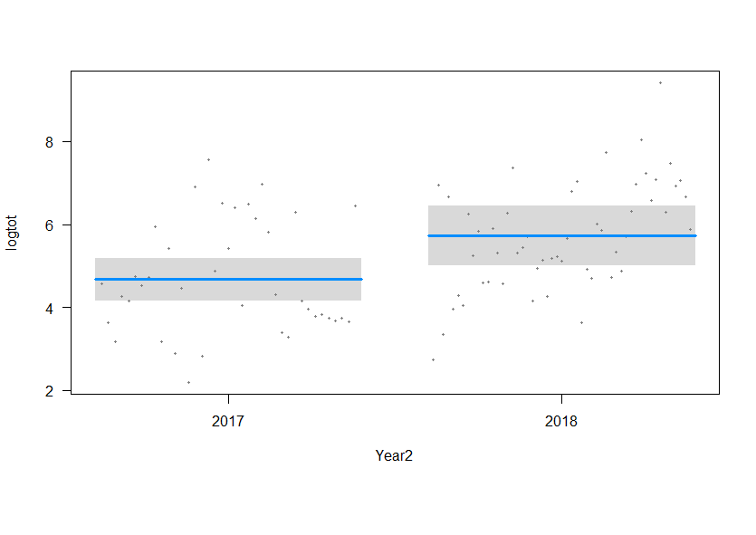
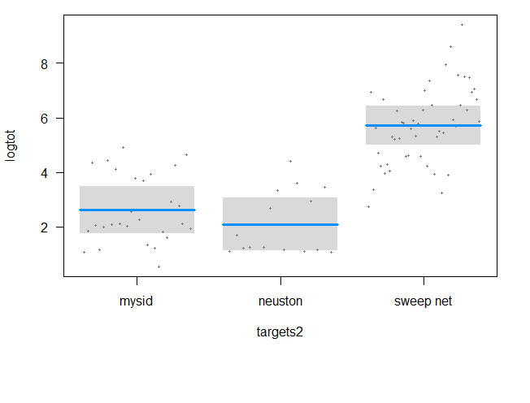
Liberty v Prospect v Miner v Flyway
Macroinvert blitz
B
A
B
A
B
A
B
 | Df Sum Sq Mean Sq F | value | Pr(>F)
site | 3 50.09 16.70 | 9.057 | 2.87E-05 | ***
targets2 | 2 229.95 114.97 | 62.367 | < 2e-16 | ***
Year2 | 1 13.58 13.58 | 7.364 | 0.00806 | **
Residuals | 85 156.70 1.84
A
A

Slide 31
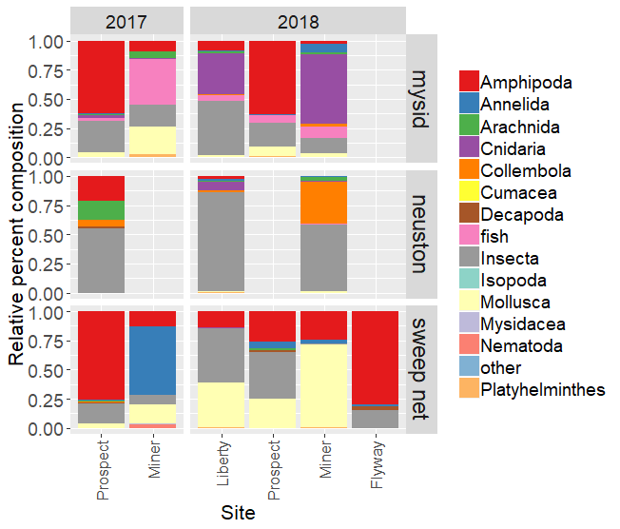
Liberty v Prospect v Miner v Flyway
Macroinvert blitz
Df SumsOfSqs MeanSqs F.Model | R2 Pr(>F)
site 3 3.7805 1.26016 9.0941 | 0.20452 0.001 | ***
Year 1 0.4823 0.48233 3.4808 | 0.02609 0.019 | *
targets2 2 2.4431 1.22156 8.8155 | 0.13217 0.001 | ***
Residuals 85 11.7784 0.13857 | 0.63721
Total 91 18.4843 | 1
---

Slide 32
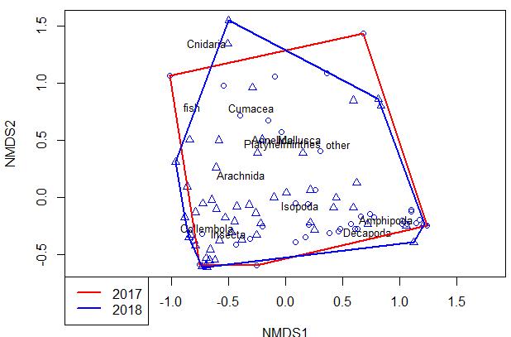
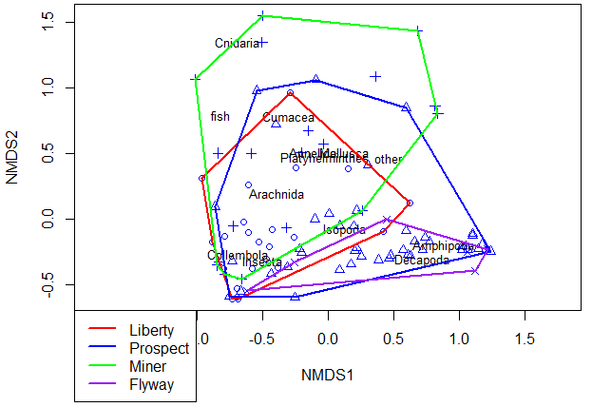
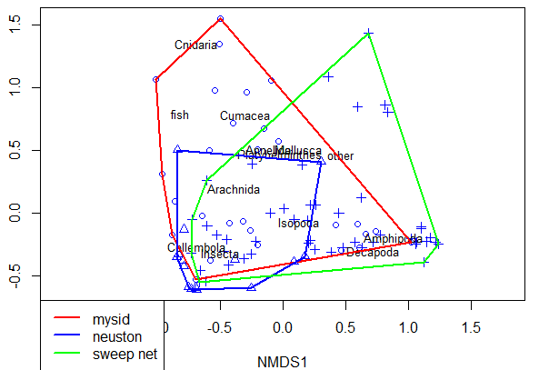
Liberty v Prospect v Miner v Flyway
Macroinvert blitz

Slide 33
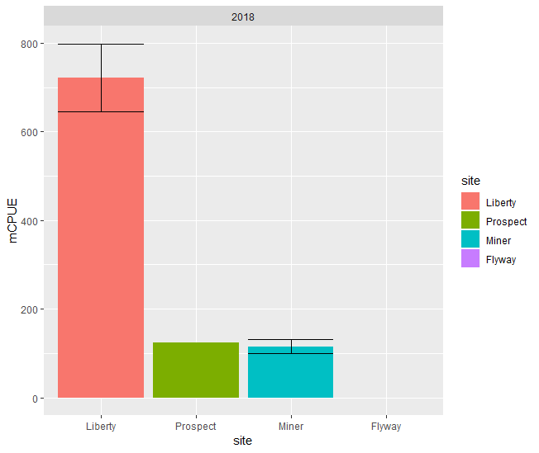
Liberty v Prospect v Miner v Flyway
Clams
Log(CPUE)~ site
 | Df | Sum Sq | Mean Sq | f value | Pr(>F)
site | 3 | 33.86 | 11.287 | 9.875 | 0.00656 | **
Residuals | 7 | 8 | 1.143
A
Tukey post-hoc
ABC
AB
 | diff | lwr | upr | p adj
Prospect-Liberty | -1.380 | -5.203 | 2.442 | 0.648
Miner-Liberty | -1.501 | -4.004 | 1.001 | 0.278
Flyway-Liberty | -6.203 | -10.025 | -2.380 | 0.004
Miner-Prospect | -0.121 | -4.207 | 3.965 | 1.000
Flyway-Prospect | -4.823 | -9.828 | 0.182 | 0.058
Flyway-Miner | -4.702 | -8.788 | -0.615 | 0.027
C

Slide 34
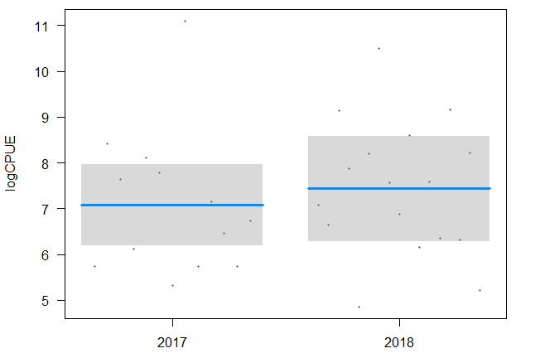
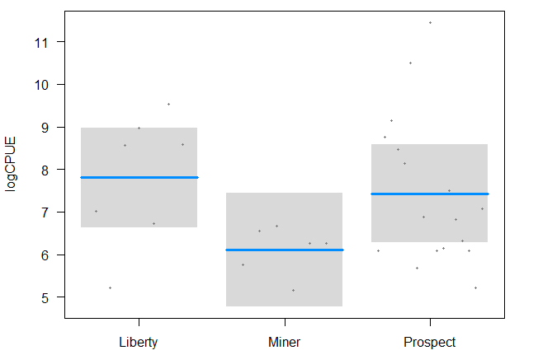
Zooplankton blitz log(CPUE) ~ site + year
Liberty v Prospect v Miner
zooplankton anova
 | Df | Sum Sq | Mean Sq | f value | Pr(>F)
site | 2 | 10.95 | 5.473 | 2.207 | 0.13
year | 1 | 0.64 | 0.643 | 0.259 | 0.615
Residuals | 26 | 64.48 | 2.48
Notes:
I need to add Yolo zoops for Flyway

Slide 35



Zooplankton blitz
Liberty v Prospect v Miner
NMDS stress = 0.155
 | Df | SumsOfSqs | MeanSqs | F.Model | R2 | Pr(>F)
site | 2 | 1.3683 | 0.68416 | 4.6267 | 0.24396 | 0.002 | **
year | 1 | 0.3958 | 0.39577 | 2.6764 | 0.07056 | 0.027 | *
Residuals | 26 | 3.8447 | 0.14787 |  | 0.68548
Total | 29 | 5.6088 |  |  | 1

Slide 36



Browns v Winter v Broad Slough
Macroinvert blitz
A
A
NS
B
B
 | Df | Sum Sq | Mean Sq | F value | Pr(>F)
site | 2 | 74.48 | 37.24 | 20.704 | 2.28E-08 | ***
targets2 | 2 | 182.1 | 91.05 | 50.622 | 2.38E-16 | ***
Year2 | 1 | 0.14 | 0.14 | 0.076 | 0.783
Residuals | 111 | 199.64 | 1.8
A
A

Slide 37

Browns v Winter v Broad Slough
Macroinvert blitz
permanova
 | Df | SumsOfSqs | MeanSqs F | F.Model | R2 | p
site | 2 | 3.2208 | 1.6104 | 10.1315 | 0.13156 | 0.001
Year | 1 | 0.8169 | 0.8169 | 5.1393 | 0.03337 | 0.001
targets2 | 2 | 2.8 | 1.40002 | 8.8079 | 0.11438 | 0.001
Residuals | 111 | 17.6435 | 0.15895 |  | 0.72069
Total | 116 | 24.4812 |  |  | 1

Slide 38



Macroinvert blitz

Slide 39



Grizzly v Ryer v Tule Red
Macroinvert blitz
C
C
A
A
B
B
 | Df | Sum Sq | Mean Sq | f value | Pr(>F)
site | 2 | 189.09 | 94.54 | 43.39 | <0.001 | ***
targets2 | 2 | 112.56 | 56.28 | 25.83 | <0.001 | ***
Year2 | 1 | 0.48 | 0.48 | 0.22 | 0.641
Residuals | 74 | 161.24 | 2.18
NS

Slide 40

Grizzly v Ryer v Tule Red
Macroinvert blitz
 | Df | SumsOfSqs | MeanSqs | F.Model | R2 | Pr(>F)
site | 2 | 5.969 | 2.984 | 16.879 | 0.269 | 0.001 | ***
Year | 1 | 0.387 | 0.387 | 2.189 | 0.017 | 0.063 | .
targets2 | 2 | 2.757 | 1.378 | 7.795 | 0.124 | 0.001 | ***
Residuals | 74 | 13.084 | 0.177 |  | 0.589
Total | 79 | 22.196 |  |  | 1.000

Slide 41



Grizzly v Ryer v Tule Red
Macroinvert blitz

